Slide 1


Designing Classes:
Operation Java
Blitz
NCC 2012 Problem Statement Solution Approach
Dr. Nannette Napier

Slide 2
1) Review the Problem
You are to build a “library” – a set of classes that can be used to accomplish related tasks
Spend 5 minutes reviewing the project description
Focus on the section called “Requirements”
On the back, look at the “Grading Criteria” and “Optional Enhancements”

Slide 3
2) Write about the Problem
On your scratch paper, jot down
What are possible class names?
What kind of input or data do you need to store in your class? (Instance variables)
What kind of behaviors or action is required with the data? (Instance methods)

Slide 4
Round 1

Slide 5
Class Name: Length
Data to store (Instance variables)
Number of miles, double
Number of yards, double
Number of feet, double
Number of inches, double
Constructors
No-arg constructor
4-arg constructor (miles, yards, feet, inches)
Generate the getters and setters
Behaviors
representAsMiles: Convert any length to miles (return an exact number of miles that this length represents as a double)
+representAsMiles():double
representAsYards: Convert any length to yards (return an exact number of yards that this length represents as a double)
representAsFeet: Convert any length to feet (return an exact number of feet that this length represents as a double)
representAsInches: Convert any length to inches (return an exact number of inches that this length represents as a double)
The toString() method will return the “common measurement” as illustrated in the requirements
plus method – adds a length to this one +plus( anotherLength:Length):Length
minus method – subtract one length from this one +minus( anotherLength:Length):Length

Slide 6
Open LucidChart and
Create the UML Class diagram for Length
LengthTester: Has main method
Create 3 Length objects
SOP each object
Add length1 plus length2. SOP the answer
Subtract length2 from length3. SOP the answer

Slide 7
Class Name:
Data to store
Behaviors

Slide 8
What I don’t like about this one…

Slide 9
Round 2

Slide 10
Class Name:
Data to store
Behaviors

Slide 11
Class Name:
Data to store
Behaviors

Slide 12
Sample library usage: Round 2
// Library must be configurable to take in
// and return exact measurements
Length length1 = new Length();
length1.addMiles(5.17045455);
Length length2 = new Length();
length2.addMiles(5).addYards(300);
// Compute length1 – length2
Length answer = length1.minus(length2);
System.out.println( answer ); // calls toString ___ miles __ yards
System.out.println( answer.asMiles() + “ miles “ );

Slide 13
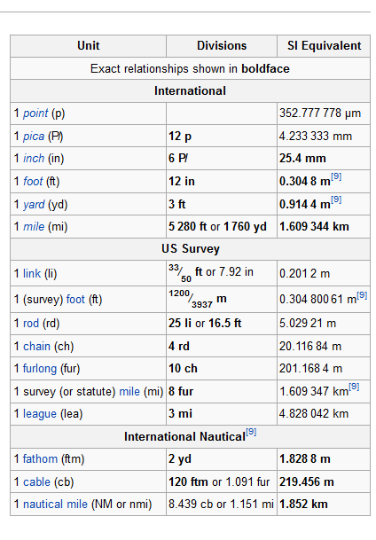
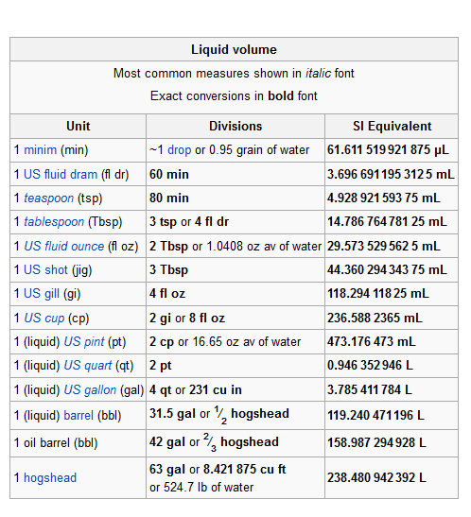

Slide 14
Caveats
There is always more than one way to solve a problem
The 2014 NCC problem may be nothing like this
Principles I consider with my approach
Time spent thinking about the problem is well worth it, but we don’t have all day!
Solution should demonstrate OO knowledge (inheritance, interfaces, abstract classes)
Solution should work!
Design to take advantage of 2 person team

Slide 15
Would also consider using
The Builder Design Pattern. Read more here: http://en.wikipedia.org/wiki/Builder_pattern
Familiarity with design patterns can make coming up with an approach a lot easier. This is a great topic for self-study

Slide 16
Resources
Practice Problems
http://www.cs.utexas.edu/users/scottm/uil/practiceMaterials.html
Advice
http://programmers.stackexchange.com/questions/109207/how-to-prepare-for-a-programming-competition-graphs-stacks-trees-oh-my
http://www.quora.com/topcoder/How-should-I-practice-so-that-I-will-be-at-a-level-where-I-can-approach-TopCoders-Div1-500-problems-with-confidence

